Slide 1

Final Project Presentation
—— OYO rental price prediction in China
Brown University, Data Science Initiative,22fall
GitHub: https://github.com/AstrosiosaurQ7/data1030_final_project.git
06/12/2022
Xiaoyan Liu

Slide 2
Content
1
Recap
2
Cross validation
3
Results
4
Improve

Slide 3


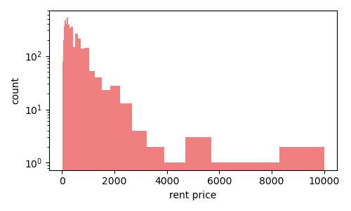
01
Target variable
Problem
Target variable ：rental price / $
Regression / Right-skewed
Feature matrix shape：(5834,25)
Data Resource
OYO APP , Chinese OTA platform : XieCheng / MeiTuan/FeiZhu
Oyo Rental Price Prediction in China | Kaggle
Kaggle
This report hopes to predict the rental price of OYO hotels according to the property type 、hotel location and so on.
Enlarge the coordinate axis by log function

Slide 4
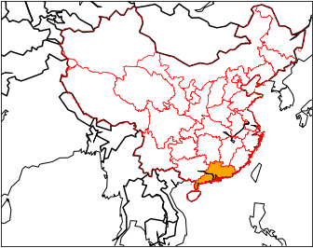
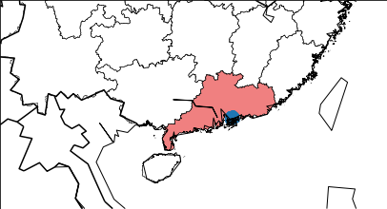
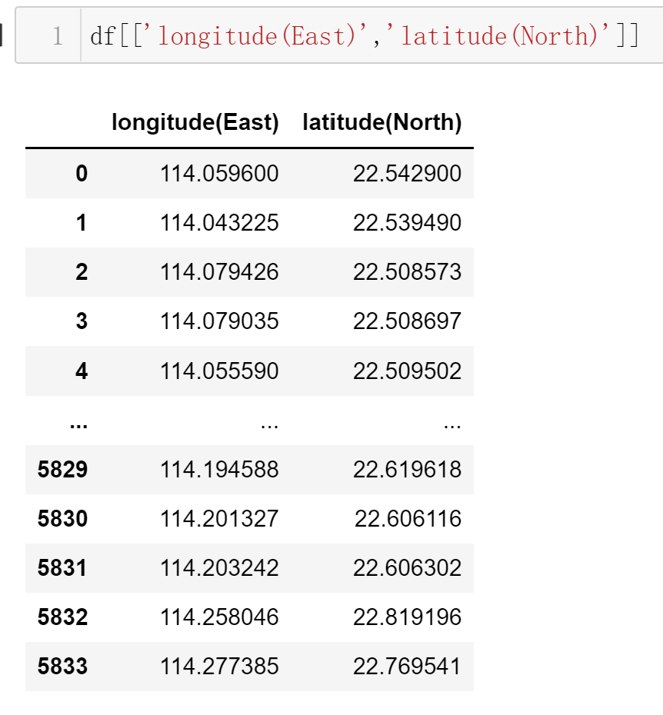
01
EDA-Location features
location
Most hotels are concentrated in the surrounding cities of Shenzhen and Hong Kong, which are near to the seaport and have developed tourism and economic industries.

Slide 5
01
Preprocessing
preprocessing
Step 1. drop worthless features : amenities, has_availability
Step 2. preprocessor encoding
One-Hot encoder : 'bed_type','host_is_superhost', 'instant_bookable', 'room_type’
Ordinal encoder : 'cancellation_policy','property_type’
MinMax Scaler: ‘accommodates','availability_30’,
'calculated_host_listings_count’, 'guests_included’, 'number_of_reviews','bathrooms', 'bedrooms', 'beds’, 'host_listings_count’,
'review_scores_checkin', 'review_scores_communication’, 'review_scores_location’, 'review_scores_rating', 'review_scores_value’
Standard Scaler : ‘maximum_nights’

Slide 6
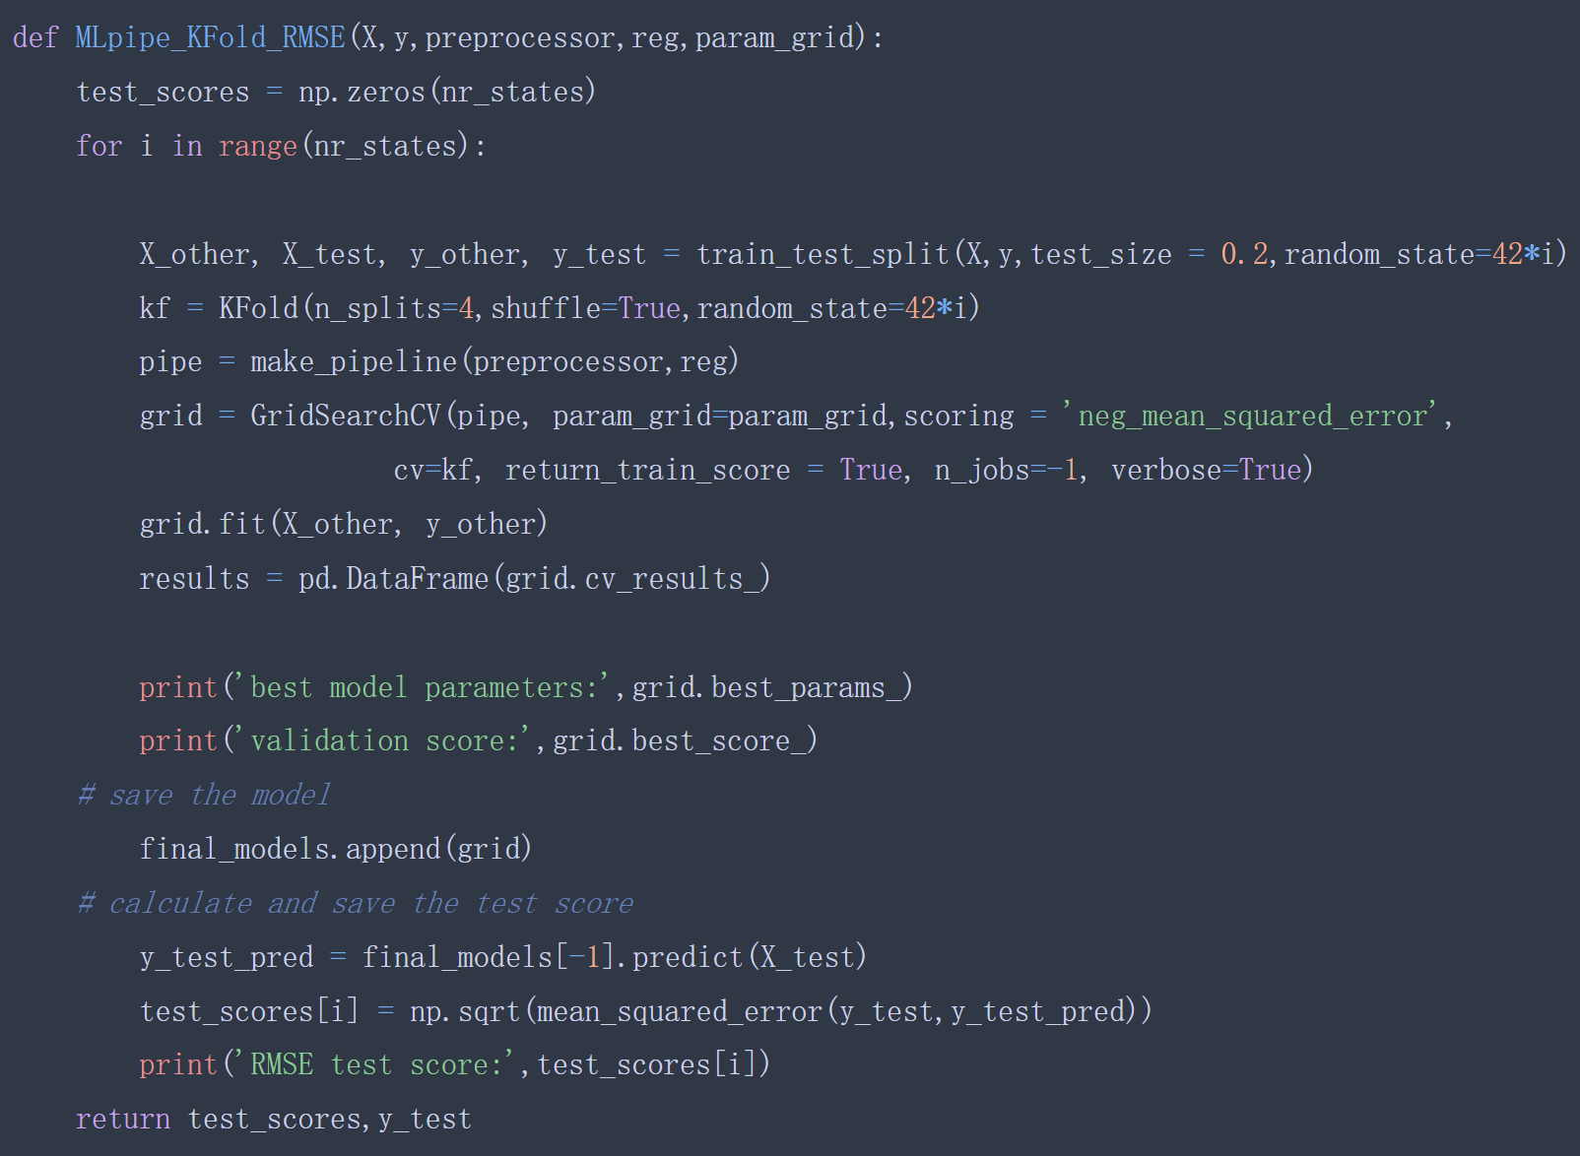
02
Cross validation
split & pipeline
def MLpipe_KFold_RMSE
Split 20% data to be test set
Used Kfold (n_splits=4,shuffle=True)
GridSearchCV function
evaluation metric= RMSE
Output best parameters and best score
Save the scores and y_test for the baseline model

Slide 7
02
Cross validation
ML algo & tune
L1 regularized linear regression(Lasso)
SVR (Support Vector)
alpha : 0.25, 2.5, 25
random_state=42
gamma: [0.1, 10, 100]
C : [0.1, 1, 10]
kernel='rbf'
RandomForestRegressor
KNeighborsRegressor(
max_features : [3, 5, 7, 9]
max_depth : [3, 5, 7, 9]
random_state=42
n_neighbors': [5, 25, 50]
weights='uniform’

Slide 8
03
Results
scores
L1 :
test score: [332.50481953, 321.1485038 , 249.33466631, 369.32089209,298.27287924, 349.18486624, 364.13289666, 258.50704218,229.58742343, 337.10134802]
test scores mean : 310.9095337515326
test scores standard deviation : 47.198
SVR :
test score: [457.0634567, 439.1388, 352.7975, 502.4557654, 409.218457, 442.50976546yy, 495.1113467, 357.6800, 299.077, 460.71044]
test scores mean : 421.576384
test scores standard deviation : 62.8157611
RandomForestRegressor :
test score: [307.10369093, 305.09515619, 215.86303583, 344.76157886,292.349, 336.76020741, 360.37117433, 239.6237,218.4528, 299.79961715]
test scores mean : 292.01818453
test scores standard deviation : 48.858289905
KNeighborsRegressor :
test score: [318.20838074, 320.60138962, 265.89838554, 371.5695846 ,289.9438, 335.33792052, 384.54992622, 252.862433 ,
222.87348307, 338.97971562]
test scores mean : 310.082503
test scores standard deviation : 49.206679

Slide 9
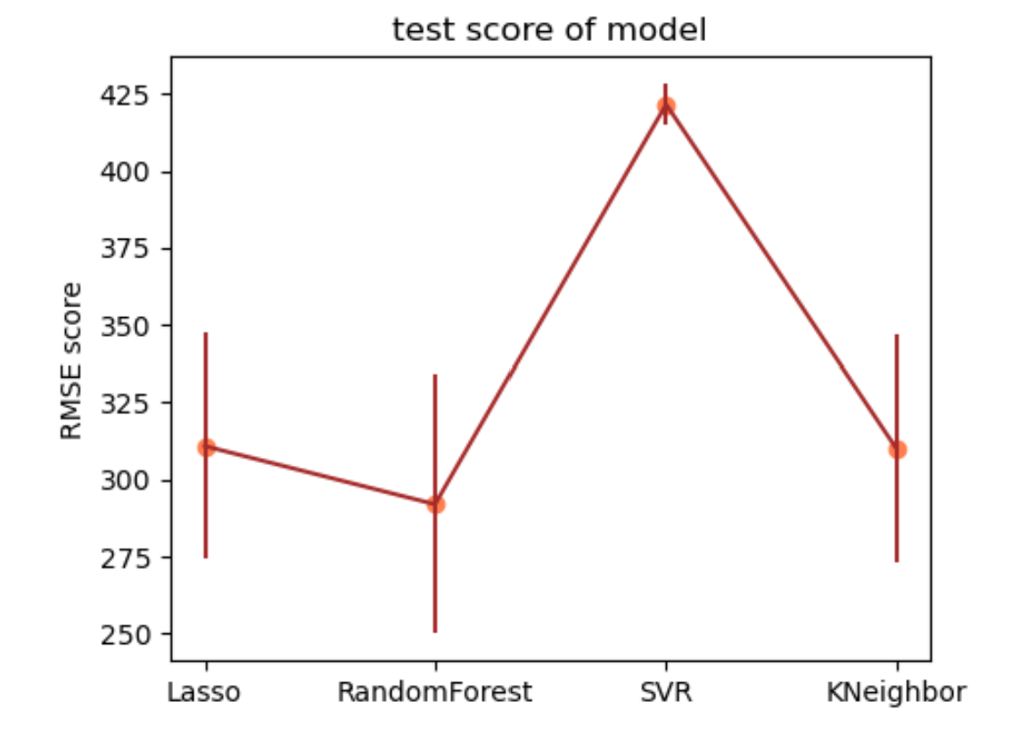
03
Results
Best model
baseline RMSE: 415.7852569807543
( y_mean=y_pred )
test scores mean : 333.64
test scores standard deviation :73.346
best model parameters: {'randomforestregressor__max_depth': 9, 'randomforestregressor__max_features': 5}
baseline

Slide 10
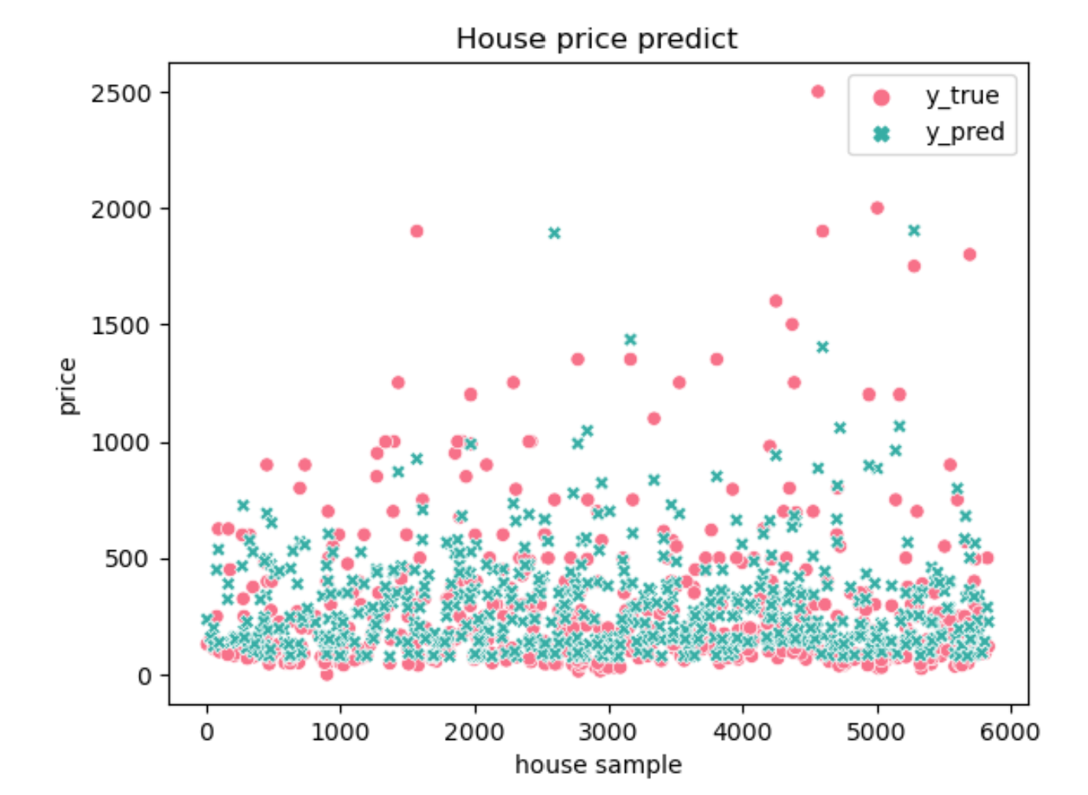
03
Results
Scatter true & pred
best model parameters: {'max_depth': 9, 'max_features': 5}
train set shape : (4667, 30)
test set shape : (583, 30)
running time 0.3580458164215088
test scores 202.72660072854498

Slide 11
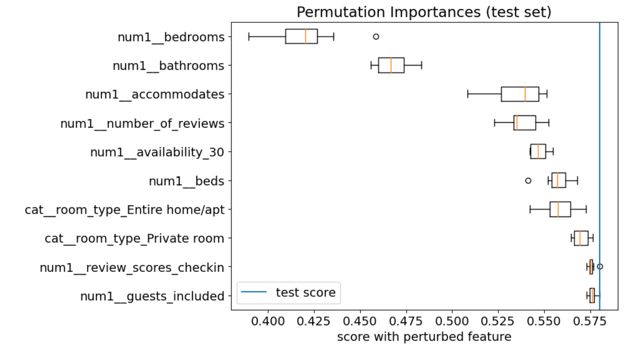
03
Results
global feature
Shuffling
TOP 10

Slide 12
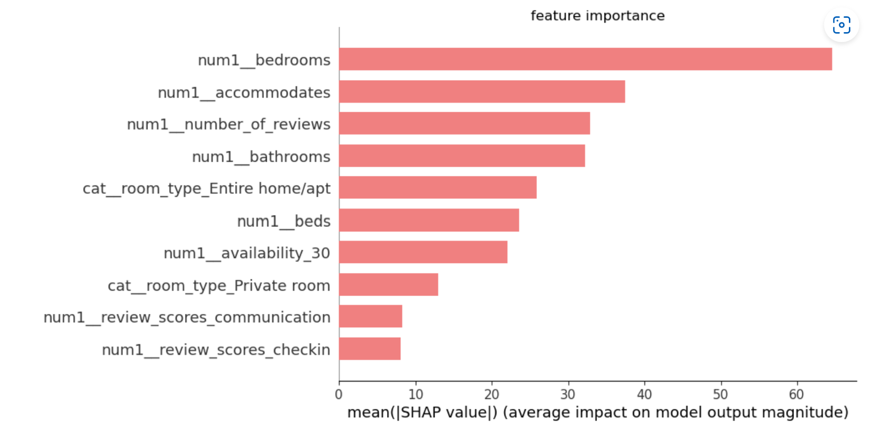
03
Results
global feature
SHAP Global
TOP 10

Slide 13
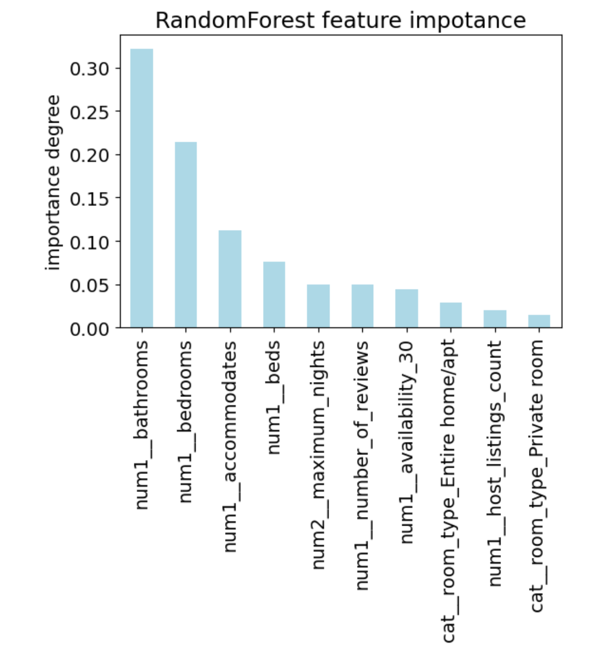
03
Results
global feature
Randomforest feature_importances function
Those results are very similar to the previous , but the sort is different.

Slide 14
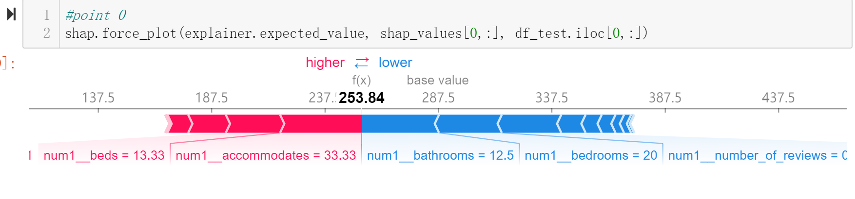
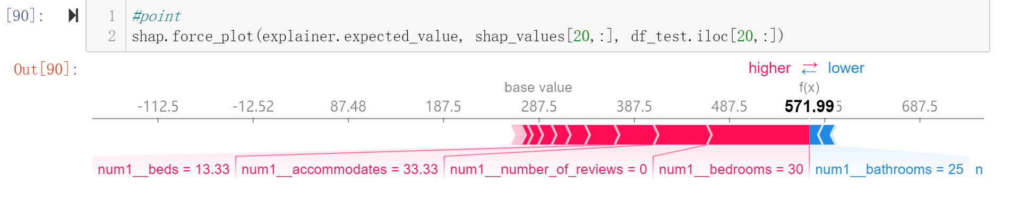
03
Results
local feature
Point 0
Point 20

Slide 15
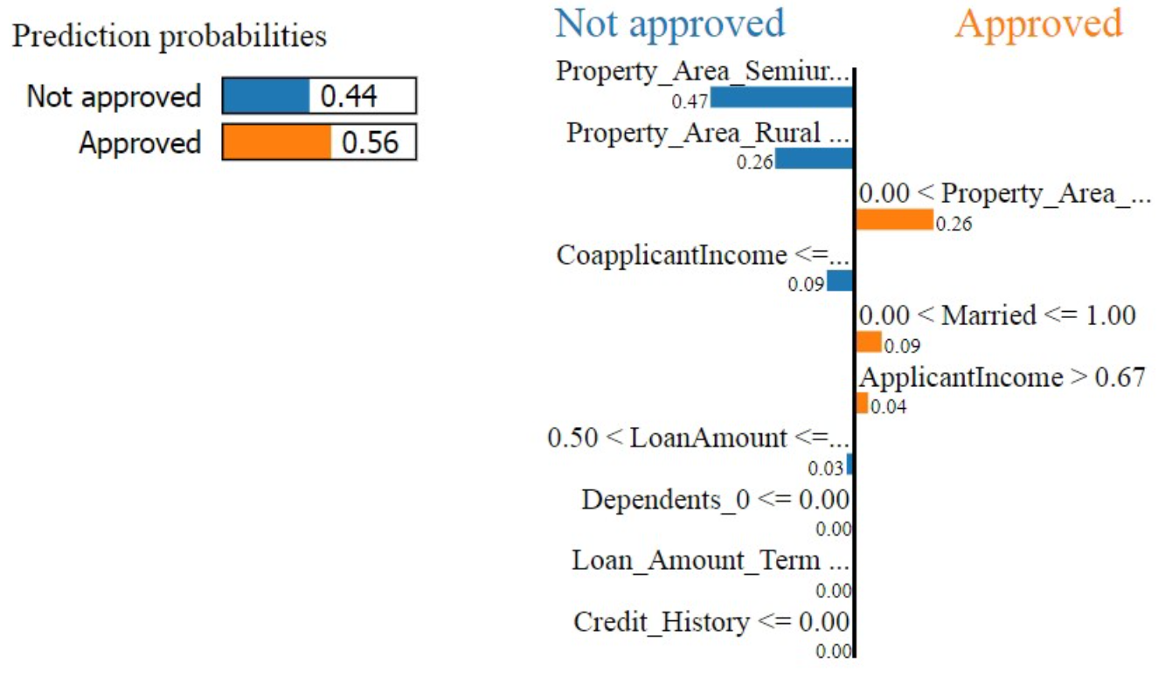
04
Improve
improve
SHAP, LIME, and Anchors, provide local, model-agnostic interpretability methods.
Reference：
https://towardsdatascience.com/three-interpretability-methods-to-consider-when-developing-your-machine-learning-model-5bf368b47fac
https://christophm.github.io/interpretable-ml-book/interpretability.html
XGBoost

Slide 16
THANK YOU FOR WATCHING

